Slide 1
Week 2 & 3
Németh Dávid

Slide 2

What I’m good at
Math
Logic
Overcomplicate stuff

Slide 3

Where i suck
Group work
Keep calm
Overcomplicating stuff
Keep on moving

Slide 4
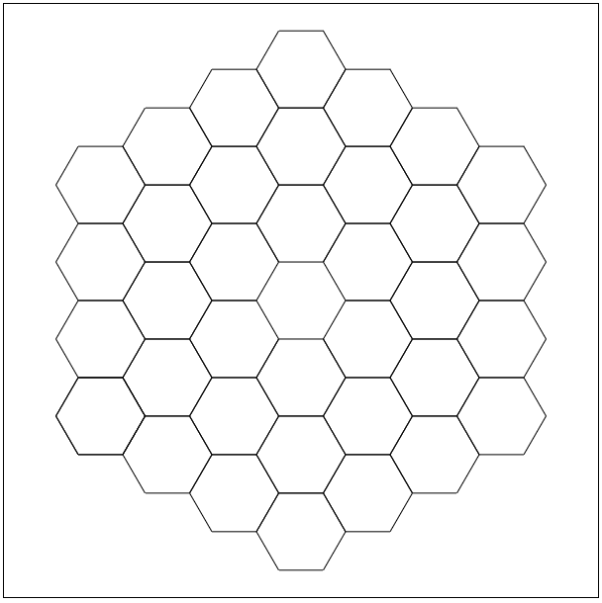


The good stuff

Slide 5
The good stuff

Slide 6
The good stuff

Slide 7
The good stuff

Slide 8
The bad stuff
Array(s)
OOP

Slide 9
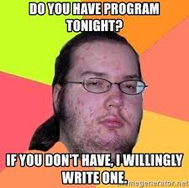
Thank you
Have a great weekend!

